Slide 1
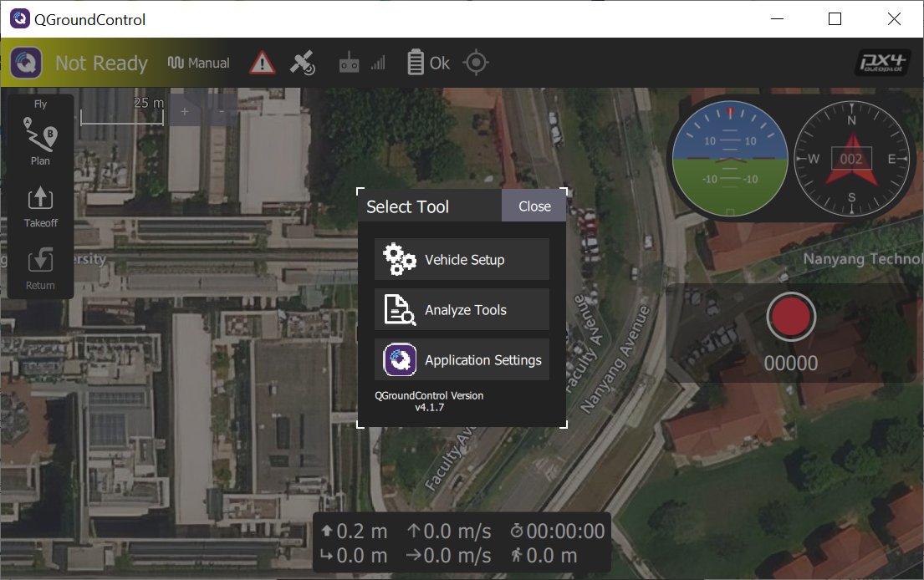
Notes:
QGC_vehicle_setup

Slide 2
①
②
Notes:
QGC_vehicle_setup

Slide 3
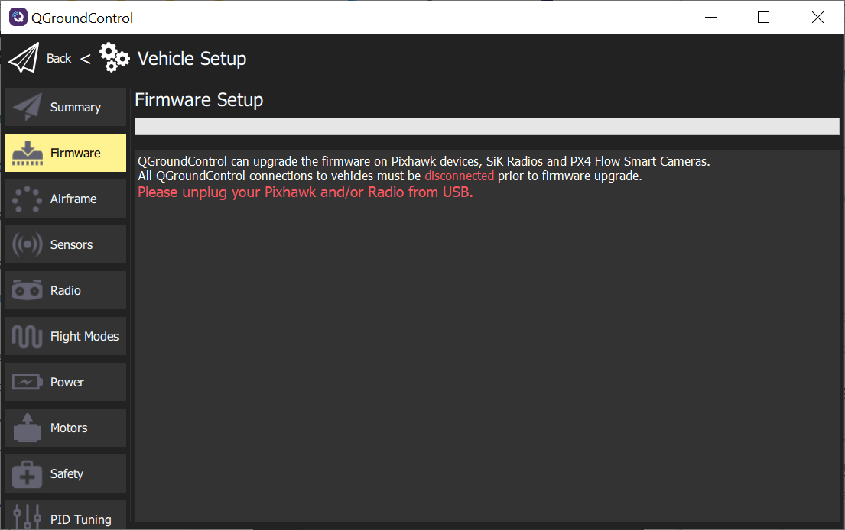
③

Slide 4
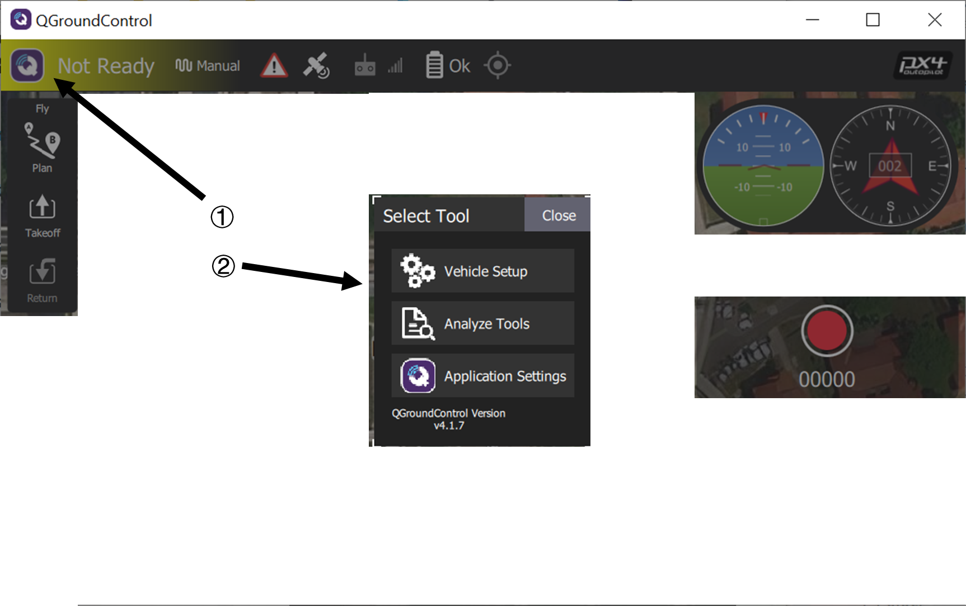
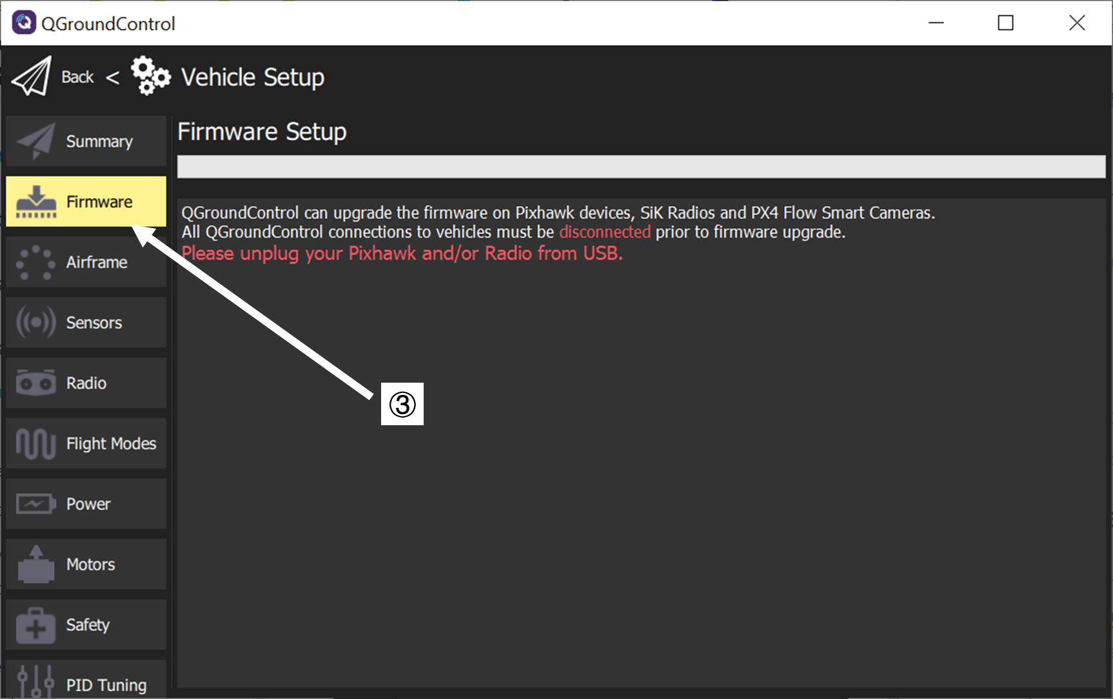

Slide 5
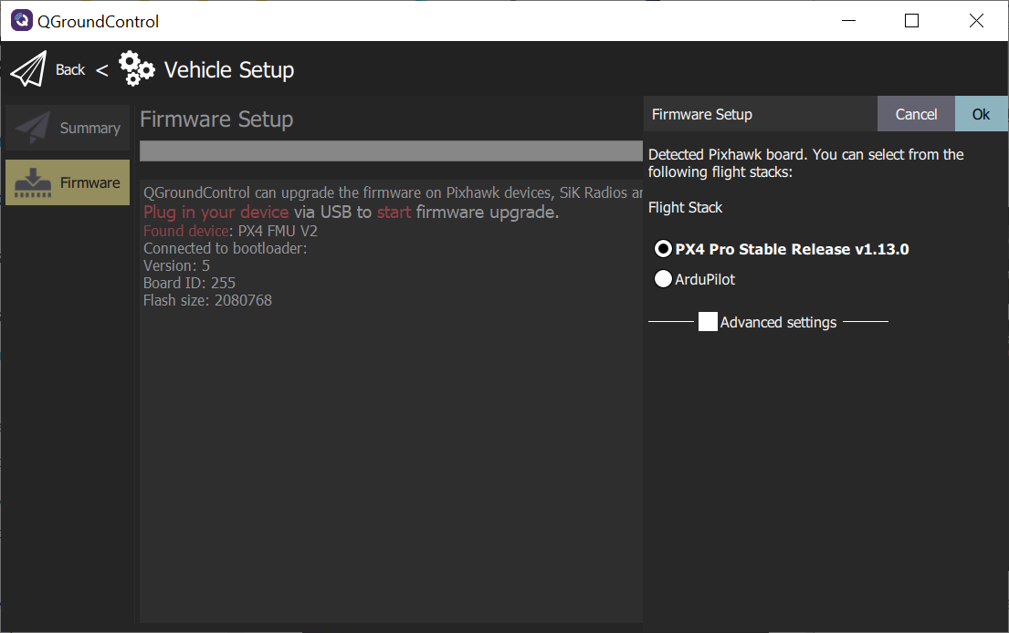
③
④
Notes:
firmware_connected_default_px4

Slide 6
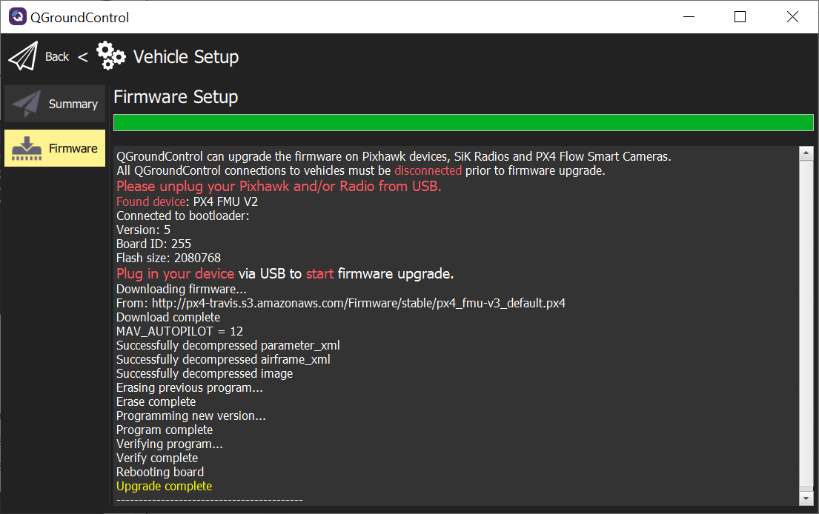

Slide 7
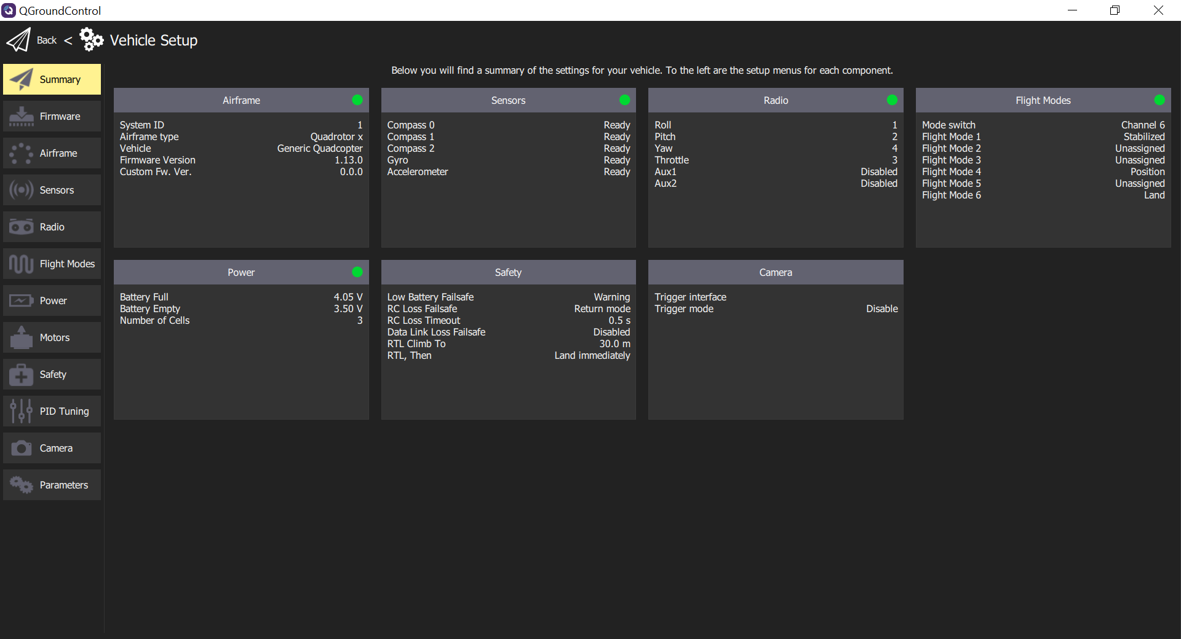

Slide 8
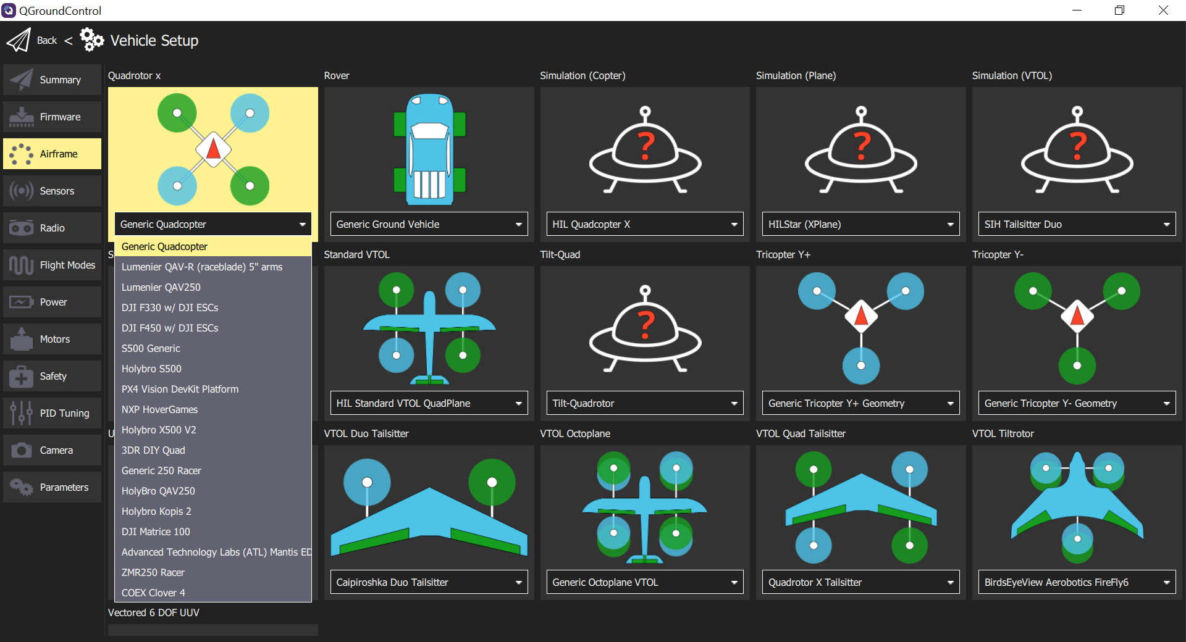

Slide 9
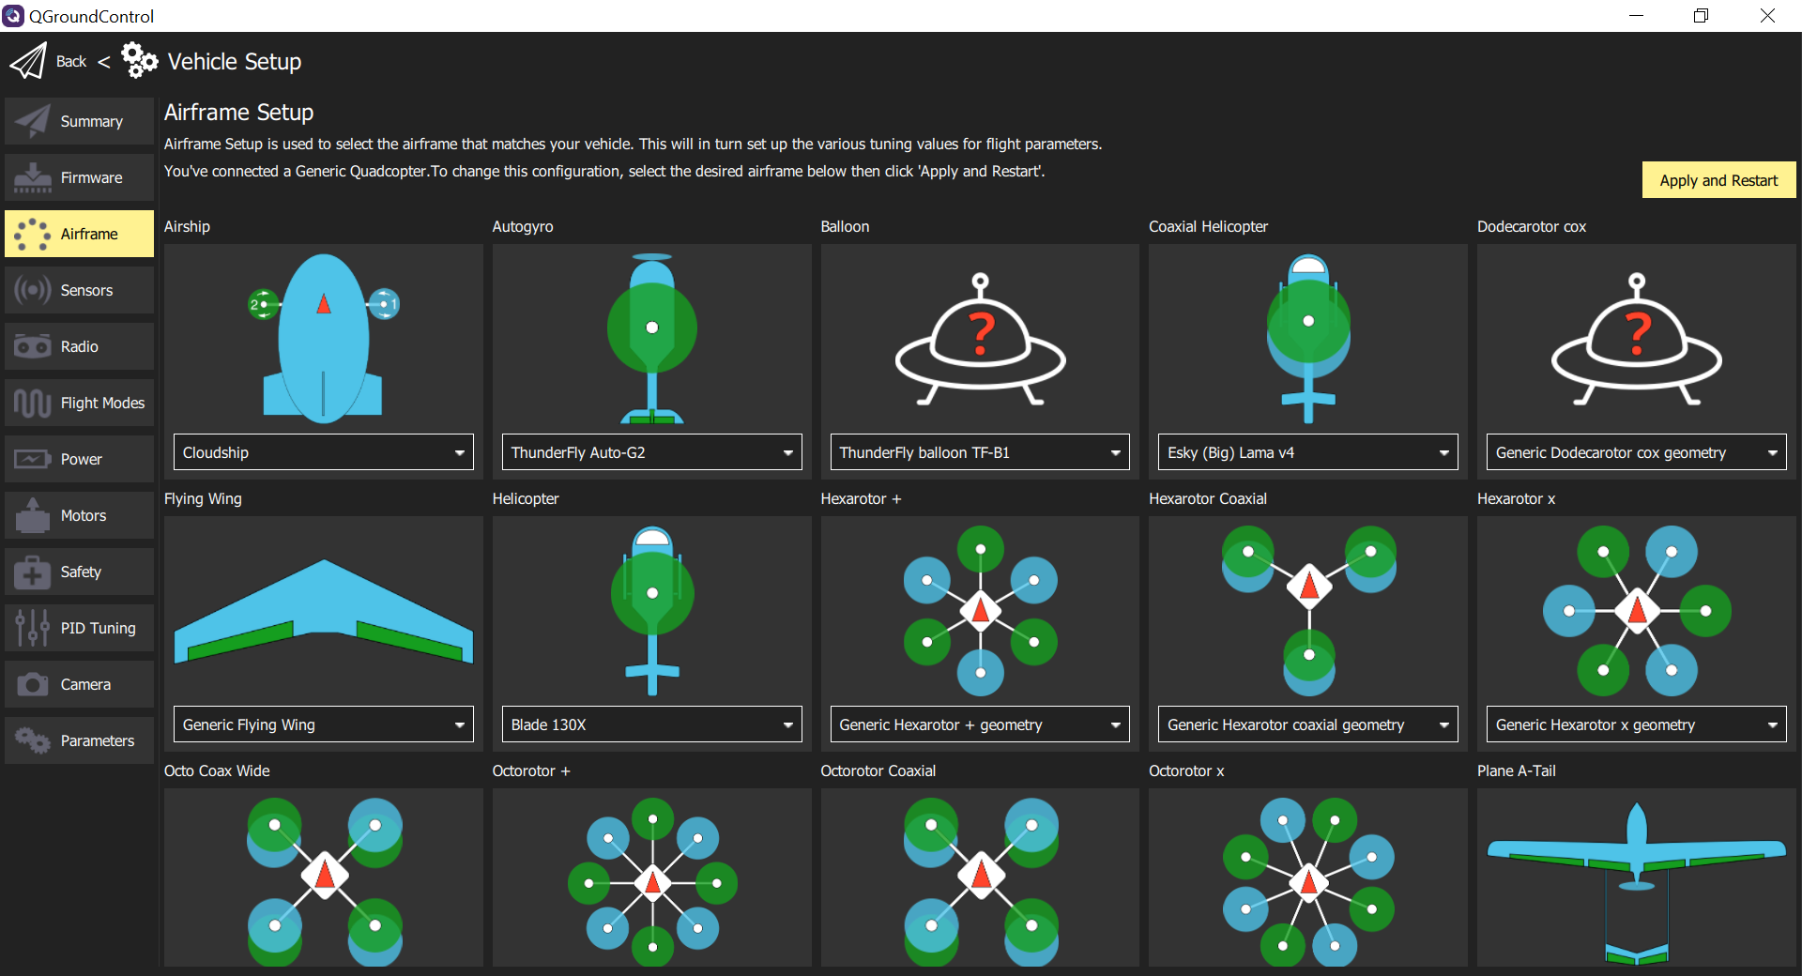

Slide 10
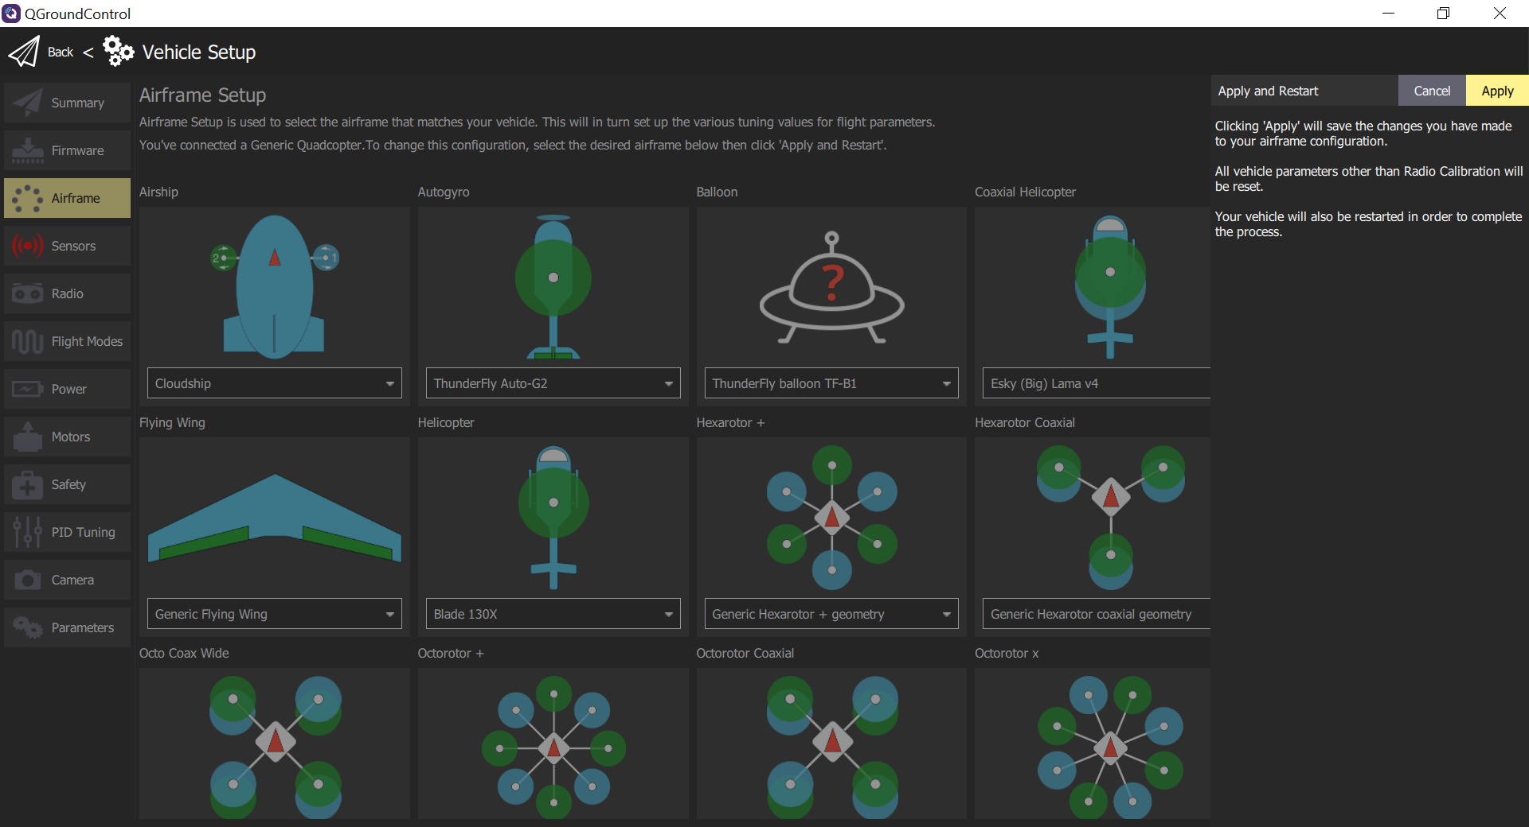

Slide 11
③.1
③.2
Notes:
airframe_px4_apply_prompt

Slide 12
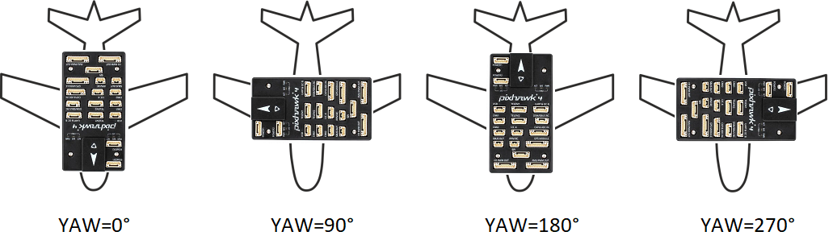
ROTATION_NONE
ROTATION_YAW_90
ROTATION_YAW_180
ROTATION_YAW_270
Notes:
yaw_rotation

Slide 13
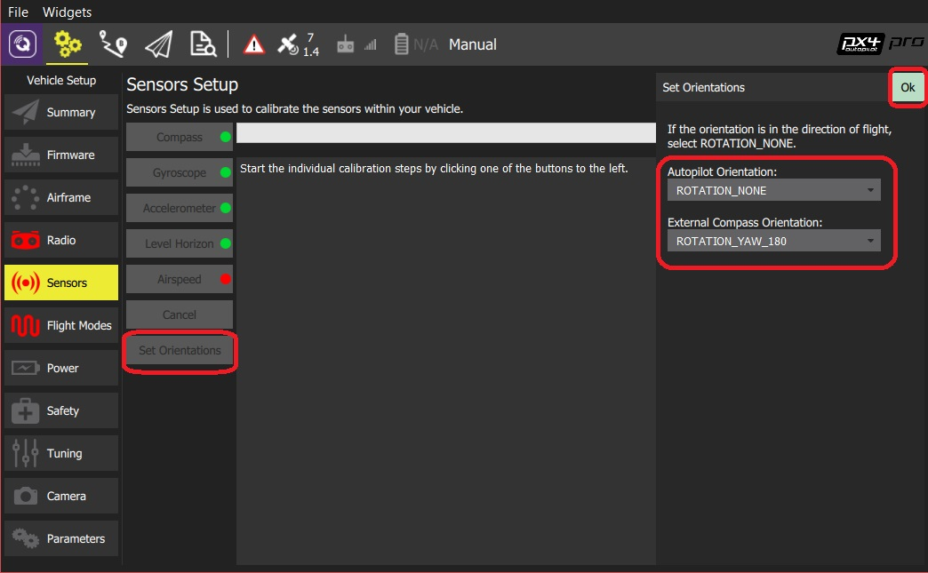
④
①
③
②

Slide 14
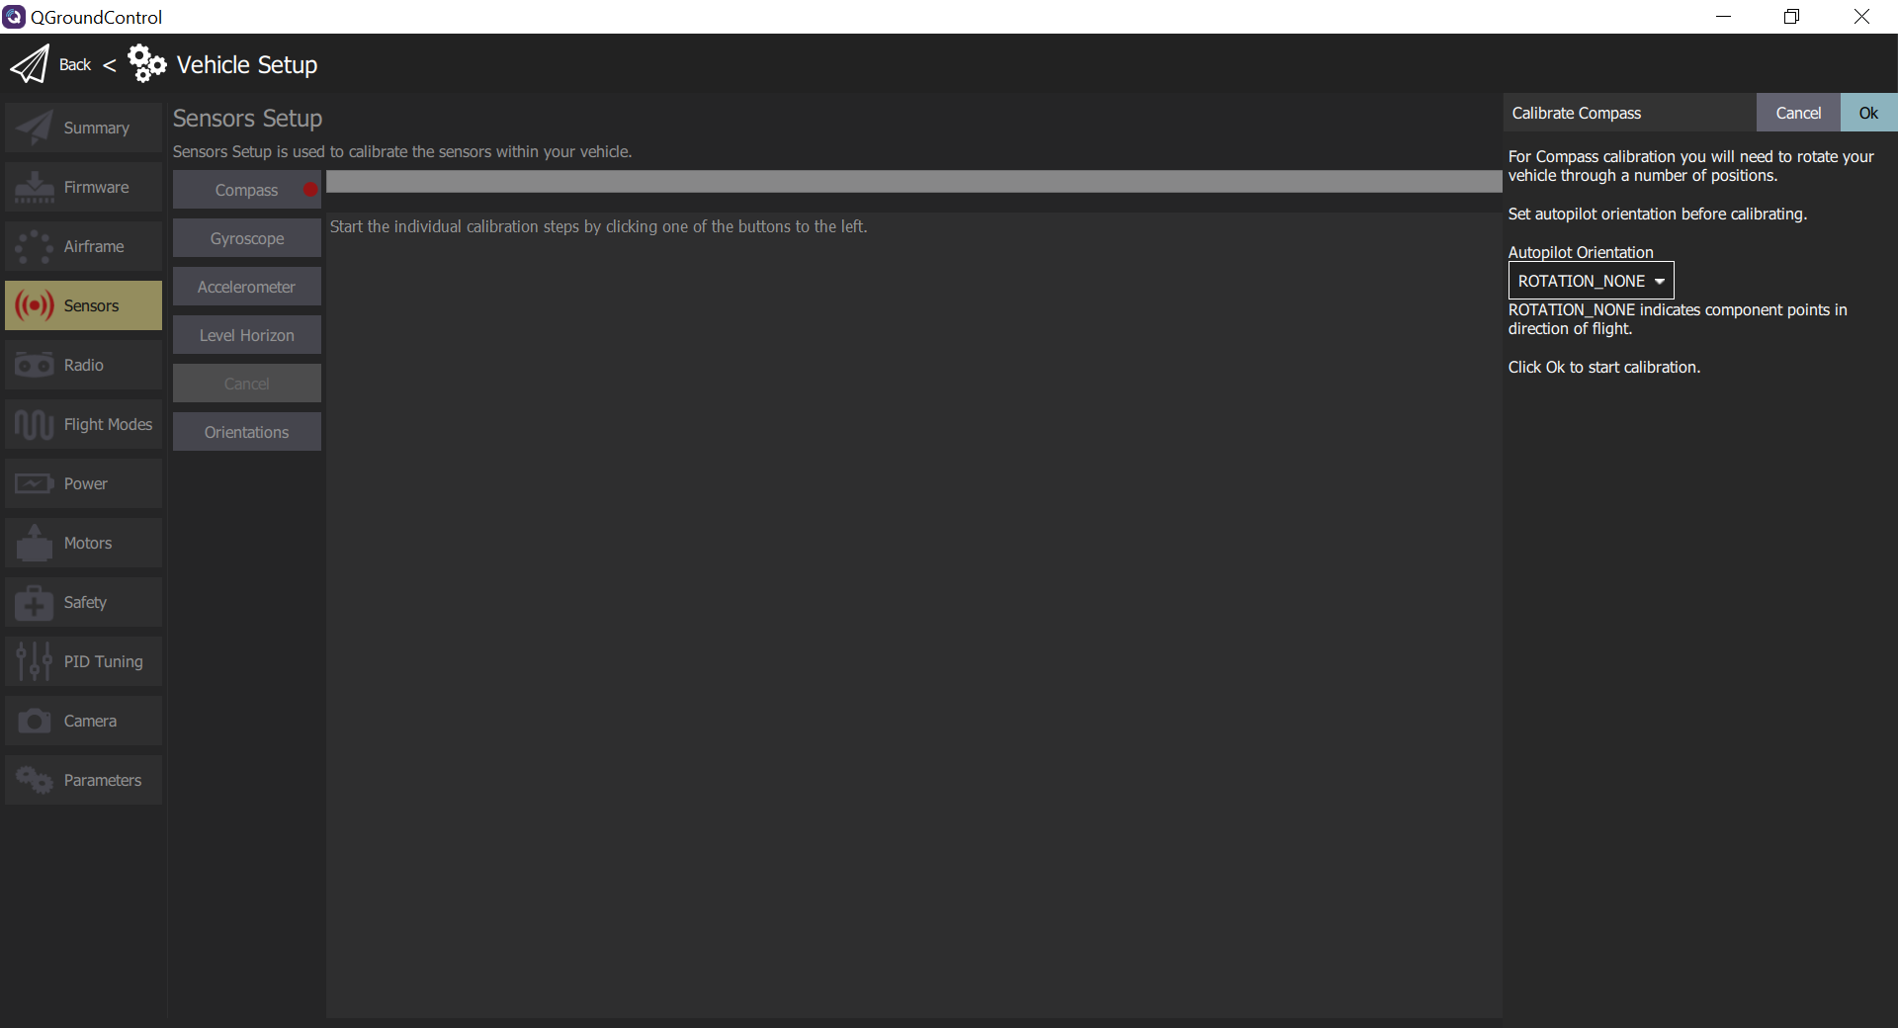
④
⑤
②
③
Notes:
sensor_compass_select_px4

Slide 15
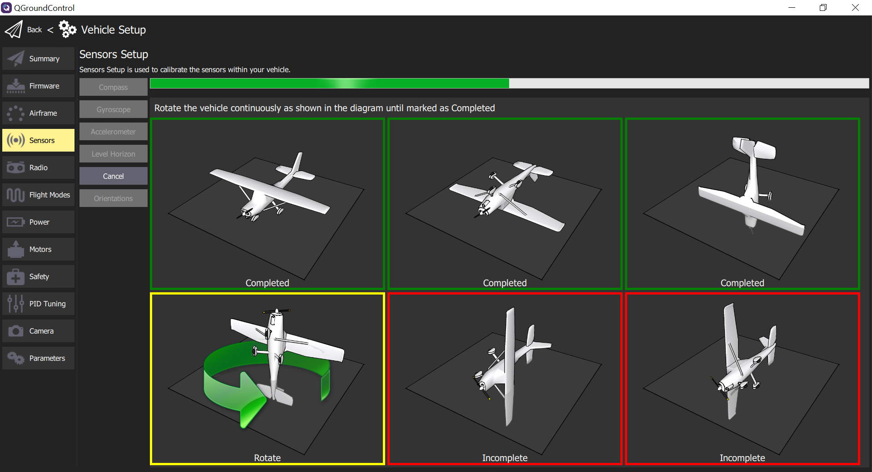
Notes:
sensor_compass_calibrate_px4

Slide 16
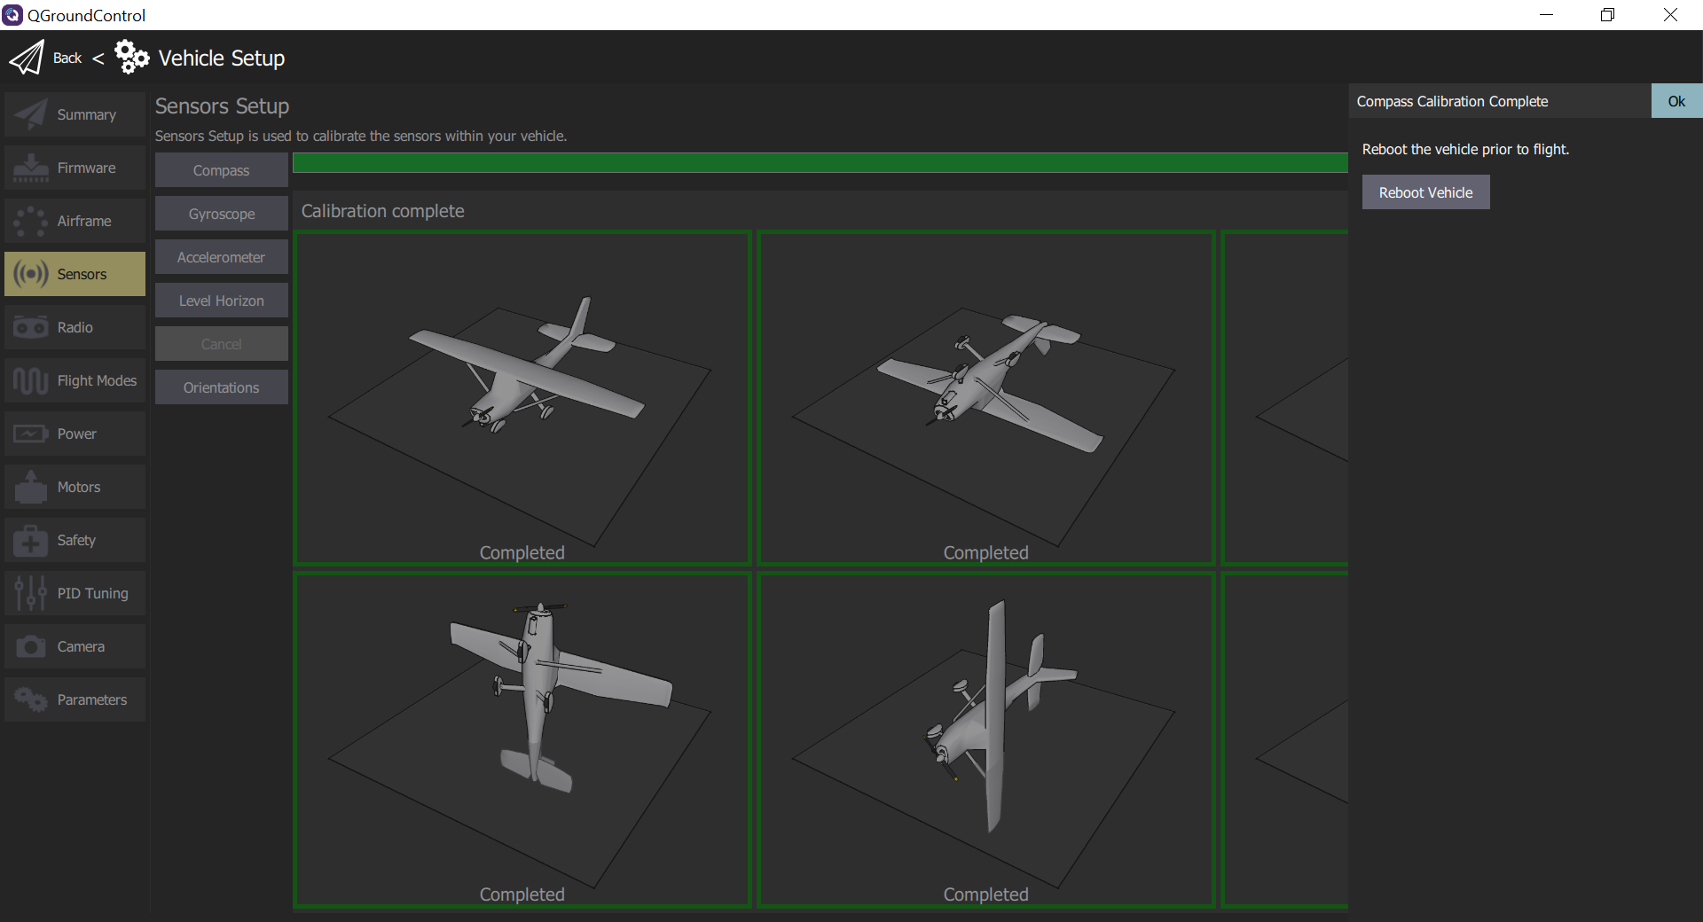
Notes:
sensor_compass_calibrate_px4_complete

Slide 17
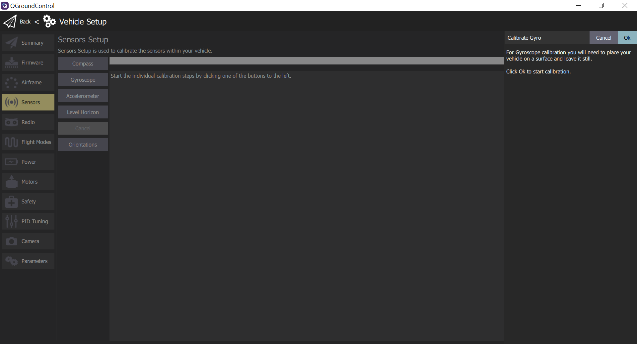
③
①
Notes:
gyroscope_calibrate_px4

Slide 18
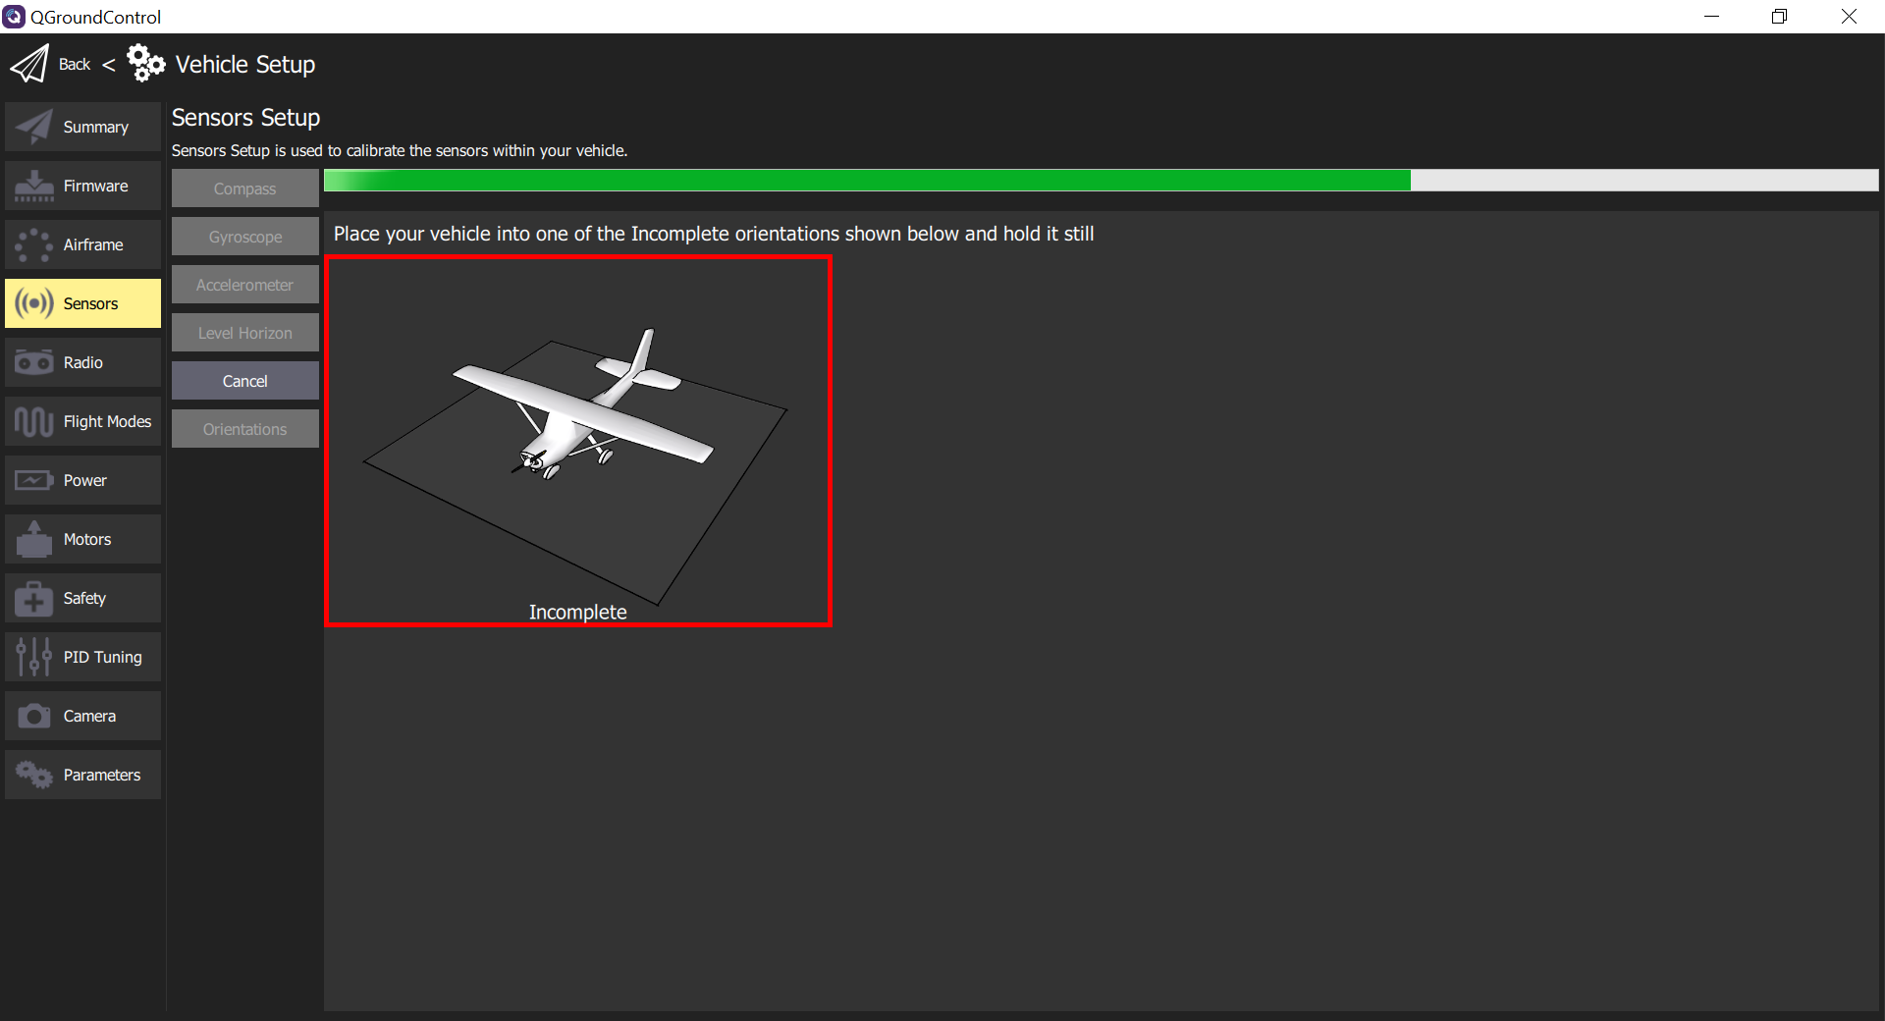
Notes:
gyroscope_calibrate_progress_px4

Slide 19
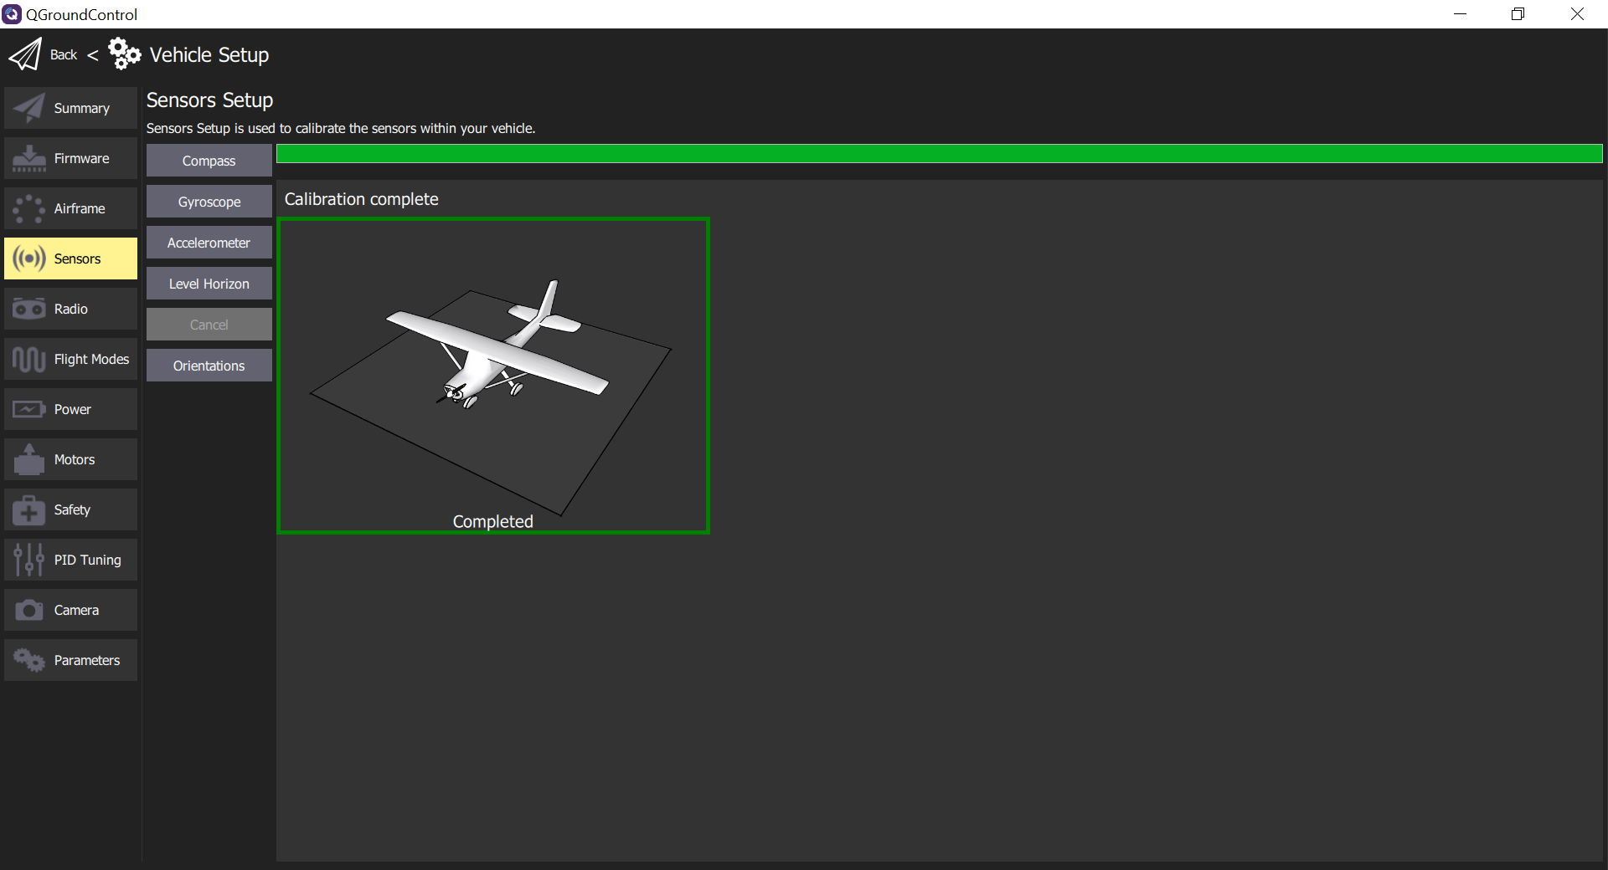
Notes:
gyroscope_calibrate_complete_px4

Slide 20
Notes:
gyroscope_calibrate_combines_px4

Slide 21
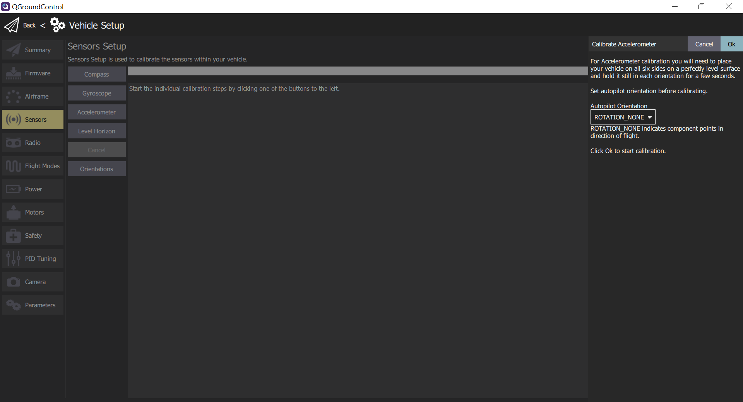
⑤
④
②
Notes:
accelerometer

Slide 22
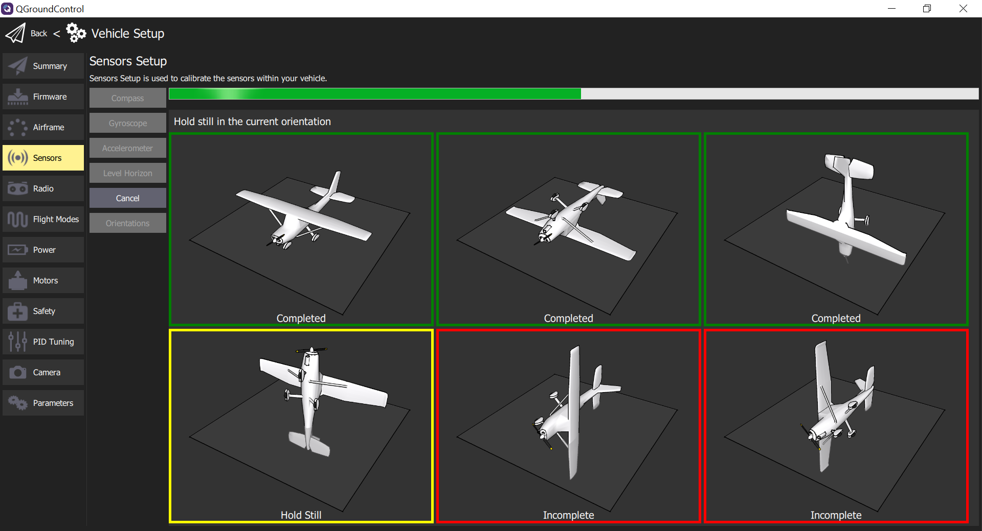
Notes:
accelerometer_positions_px4

Slide 23
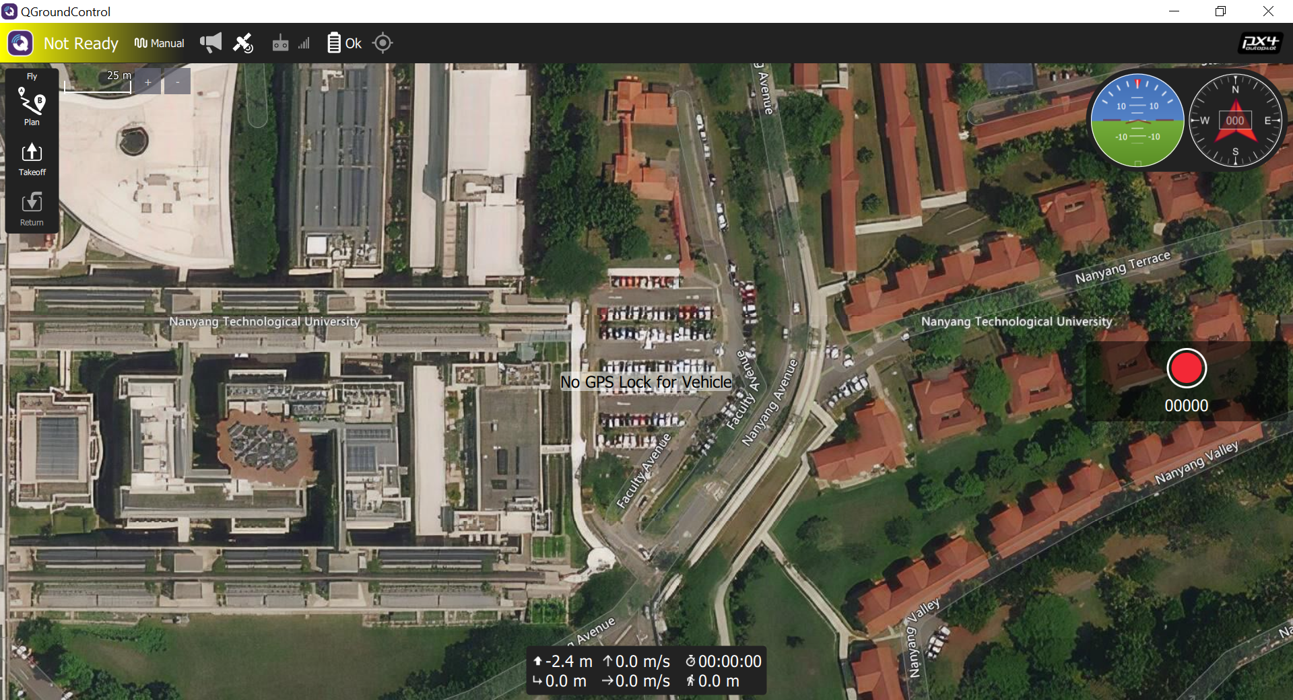
Notes:
calibration_verification

Slide 24
Notes:
calibration_verification

Slide 25
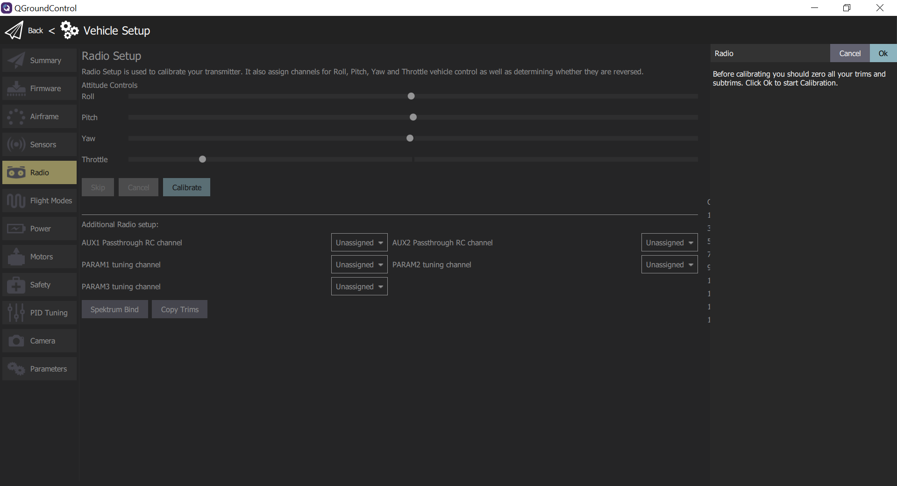
⑤
③
④
Notes:
radio_start_setup

Slide 26
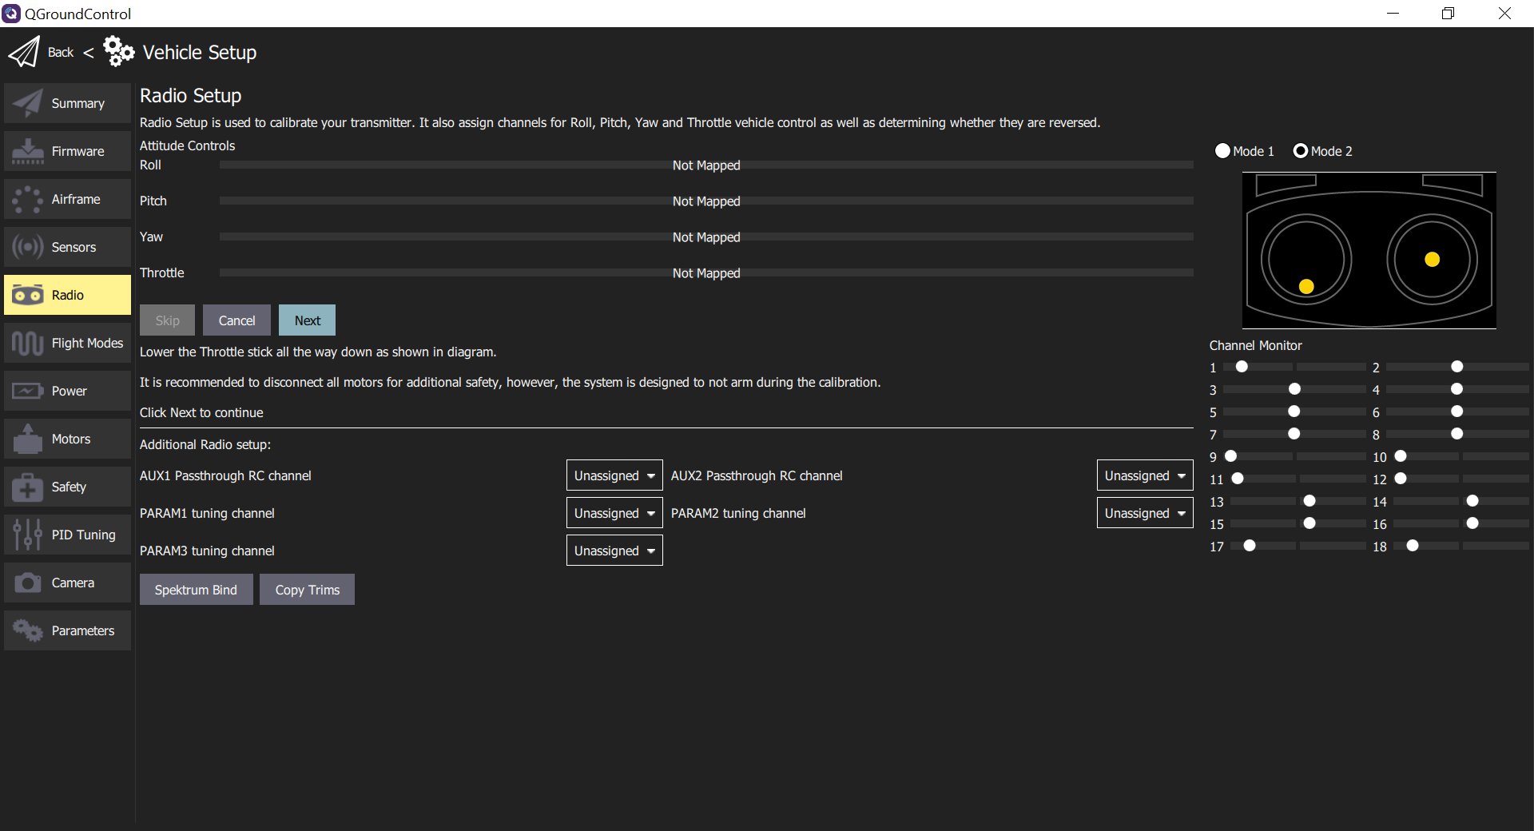
⑥
⑦
Notes:
radio_sticks_throttle

Slide 27
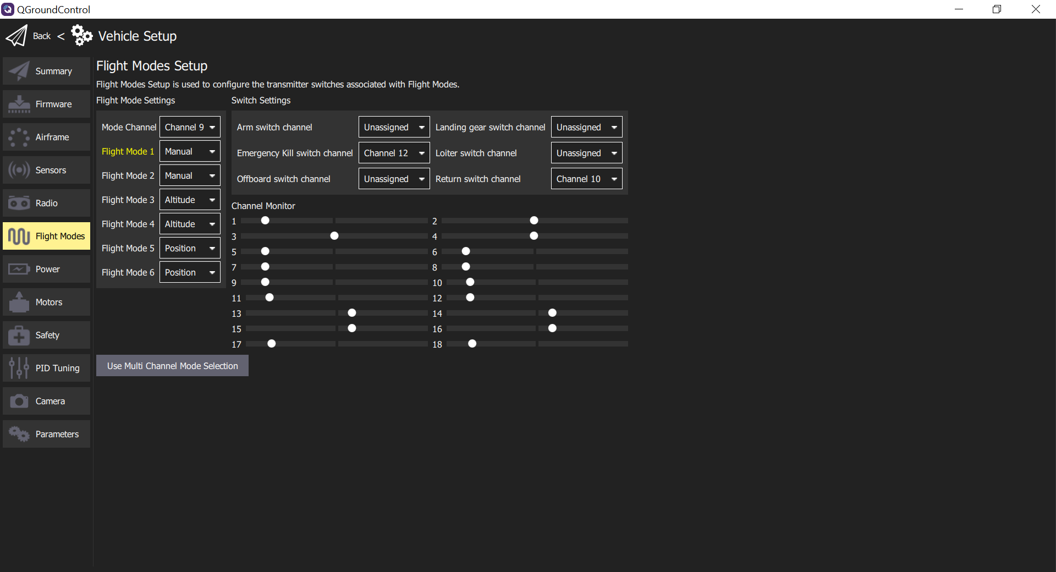
③
⑤
④
⑥
②
Notes:
flight_modes_single_channel

Slide 28
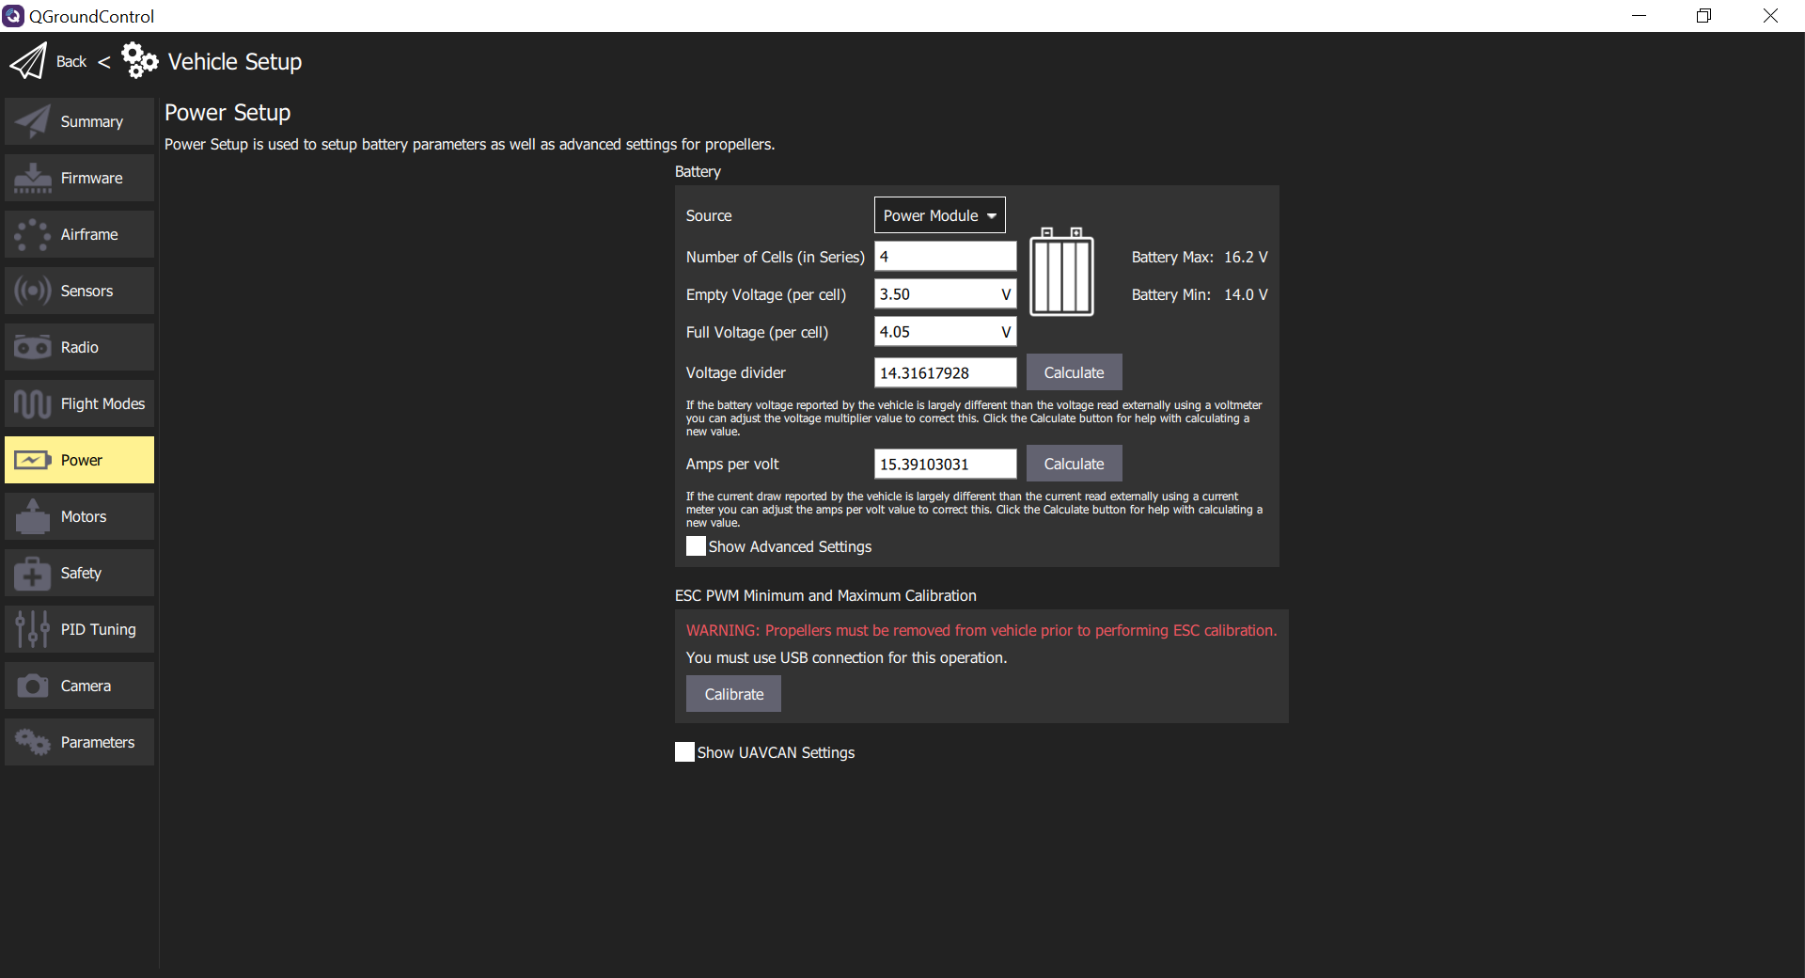
③
④
⑤
⑥
②
⑦
Notes:
qgc_setup_power_px4

Slide 29
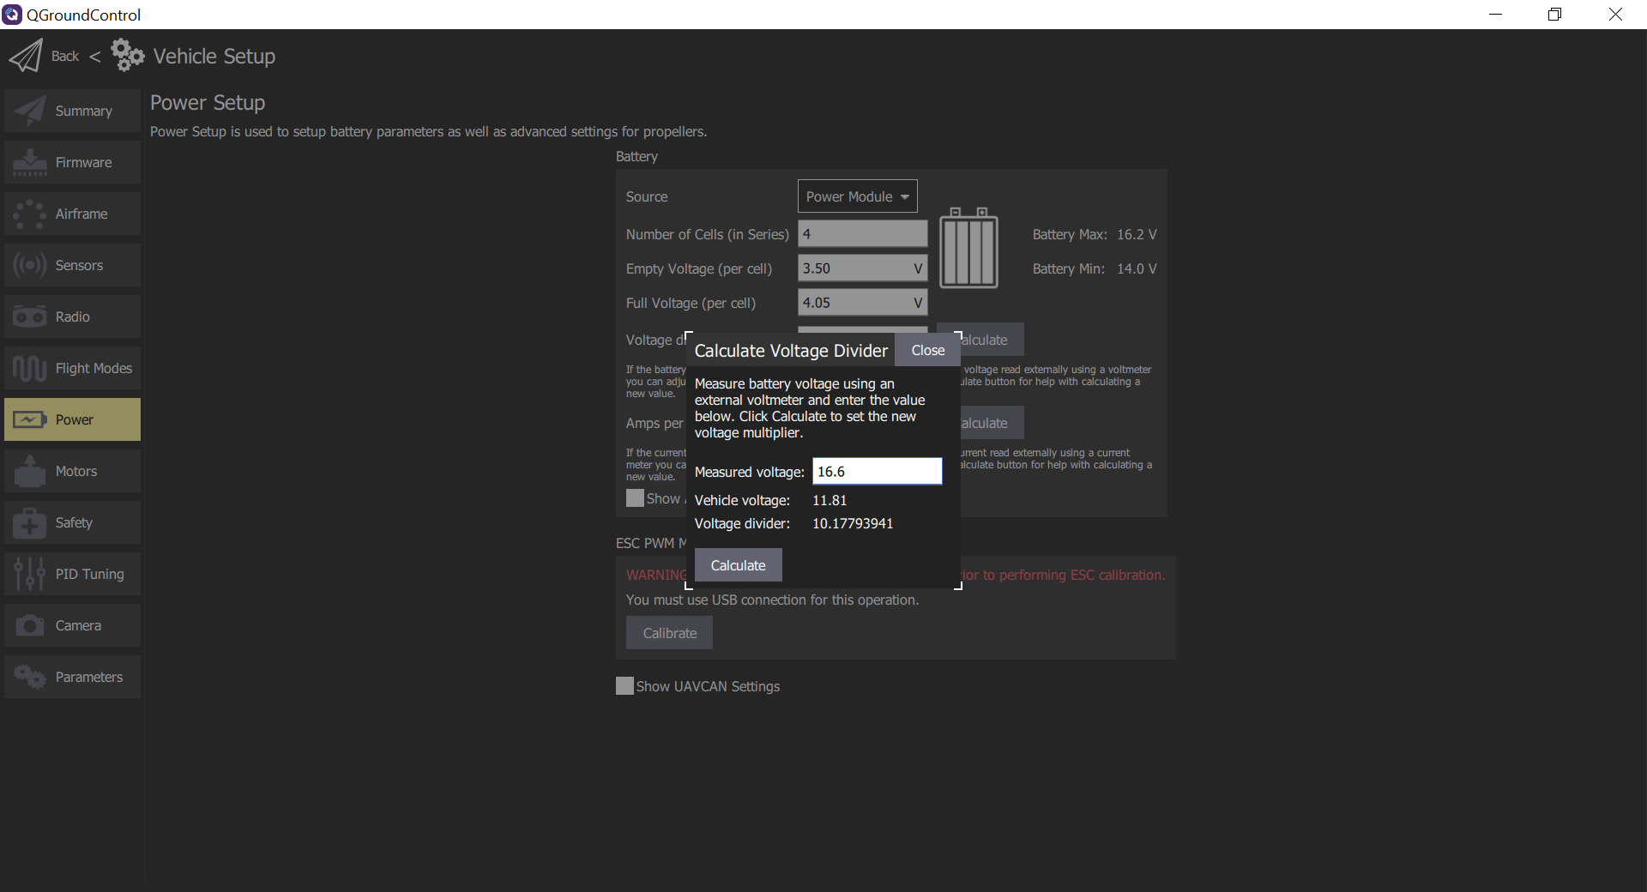
Notes:
qgc_setup_power_px4_v_div

Slide 30
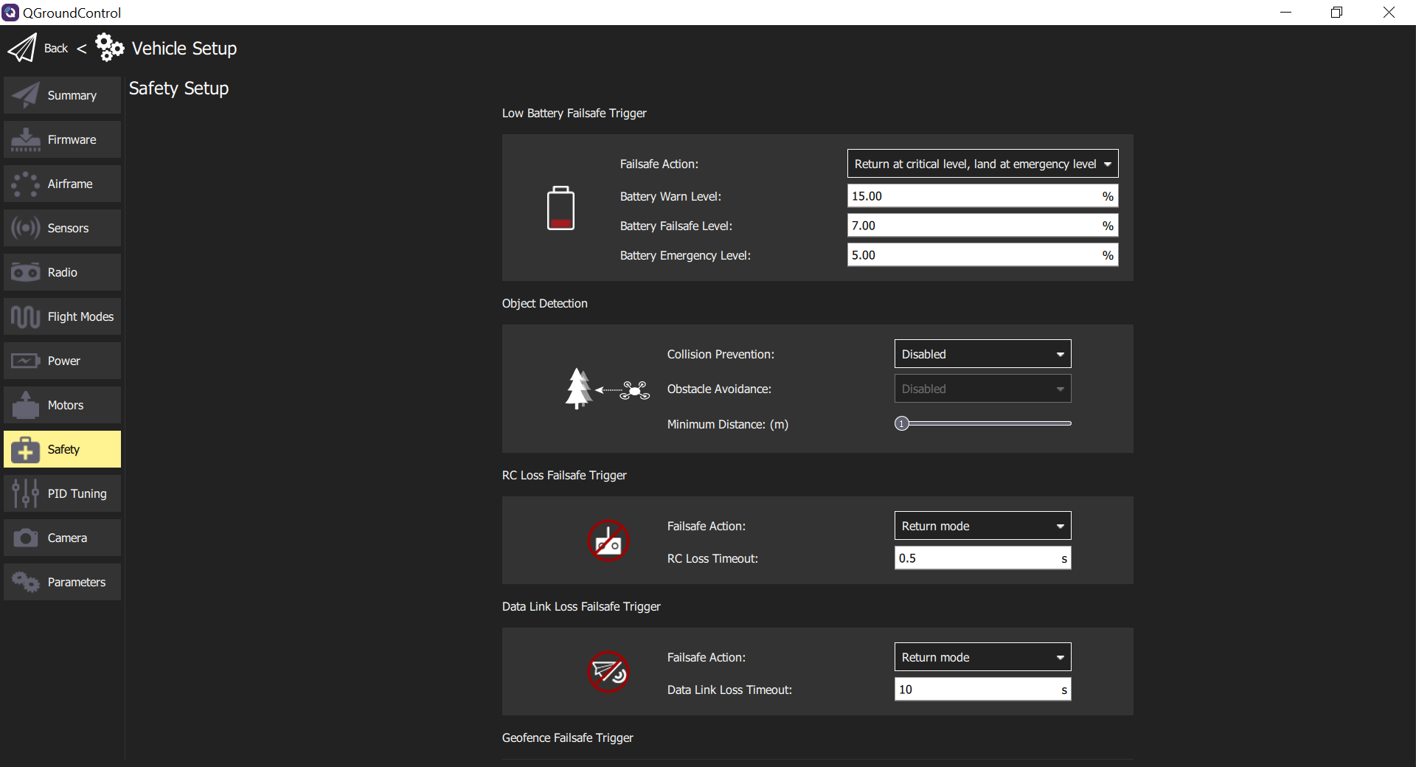

Slide 31
Notes:
safety_battery

